Slide 1
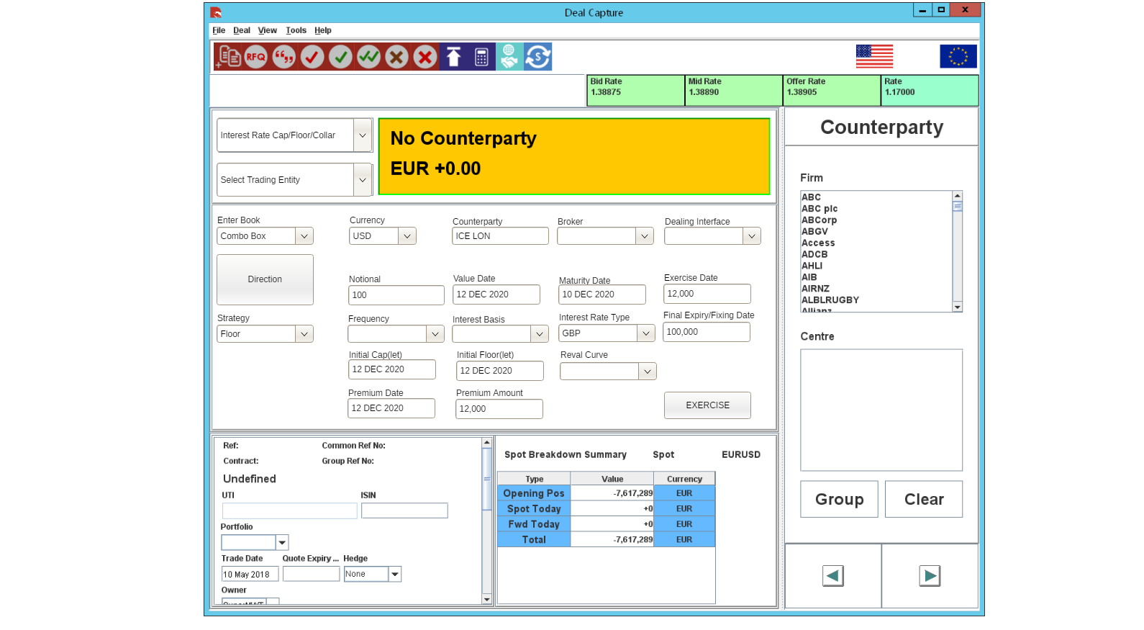

Slide 2
Cap, Floor or Collar

Slide 3
Deal Capture Fields
Field Name | Narrative
Select Deal Type | Users will be able to select IR Option as the deal type
Trade Entity | Standard deal capture selection
Enter Book | Standard deal capture selection
Currency | Standard deal capture selection
Counterparty | Standard deal capture selection
Direction [1] | There are six possible directions : - BUY CAP SELL CAP BUY FLOOR SELL FLOOR BUY CAP/SELL FLOOR ** SELL CAP/BUY FLOOR ** ** The last two are used with Collars
Notional Amount | Standard amount – allow up to decimal places. Represents the notional amount of the IR Option
Value Date | Start date for the option. Standard deal capture date selection.
Maturity Date | Maturity date for the option
Option Strategy [2] | Dropdown. This will default to Collar where the deal direction is either : - BUY CAP/SELL FLOOR ** SELL CAP/BUY FLOOR ** Direction assumes a bank transaction i.e. Bank Sells – Customer Buys and vice versa
Frequency | Standard deal capture selection
Interest Basis | Standard deal capture selection
Interest Rate Type | Standard deal capture selection
Final Expiry/Fixing Date [3] | This should default to nn fixing days before the maturity date or next interest date for multi-legged IR Options.
Broker | Standard deal capture selection
Initial Cap(let) [5] | Enter an interest rate value – allow for up to 6 decimal places – also populates 1st leg in the deal legs if multi-legged
Initial Floor(let) [5] | Enter an interest rate value – allow for up to 6 decimal places – also populates 1st leg in the deal legs if multi-legged
Dealing Interface | Standard deal capture selection
Premium Amount [4] | Users can enter a manual value or the system can default a fair value – see pricing
Premium Date | This is date when the premium generates a cash-flow movement. Users enter or select a date.
Reval Curve | This is the Curve used for pricing and revaluation for the IR Option
Exercise [6] | As IR Options use a European Style, the option button will only become enabled on the expiry date of the option. When the exercised button is hit, the label on the button will change from “Exercise” to “Exercised”.
Exercise Date | When the Exercise button is hit the system will populate this field with the trade date. Non editable field

